Slide 1
GAO GETTER
ANALYZING WHAT IT TAKES TO SECURE A GOVERNMENT CONTRACT
By Billy Hayes

Slide 2
TABLE OF CONTENTS
01
02
03
BACKGROUND
PROCESS
RESULTS
Problem statement, data source, and approach
Web scraping, cleaning, analysis, and model building
Overall conclusions and possible future work

Slide 3
BACKGROUND
01
Using data science to secure more government contracts

Slide 4
PROBLEM STATEMENT
Booz Allen Hamilton is a consulting company that secures most of its work from government contracts. Where can we find data about which companies win and lose contracts?

Slide 5

GOVERNMENT ACCOUNTABILITY OFFICE (GAO)
gao.gov

Slide 6
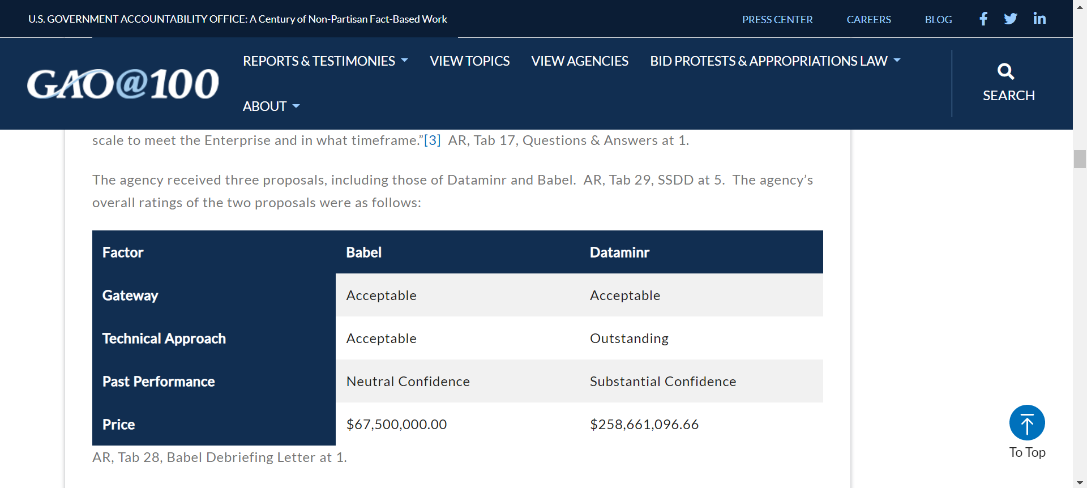
BID DECISIONS
Protest B-418730.5,B-418730.6
Released June 25, 2021

Slide 7
BID DECISIONS
Protest B-418730.5,B-418730.6
Released June 25, 2021

Slide 8
PROCESS
02
How various insights were extracted from GAO bid proposals

Slide 9
WEB SCRAPING

Slide 10
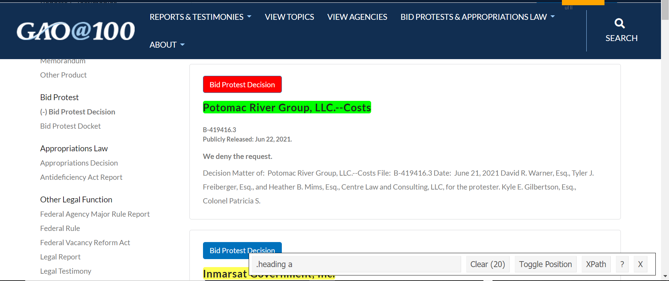
SCRAPY
Using SelectorGadget to find CSS selectors for data extraction from gao.gov

Slide 11
SCRAPY
Using SelectorGadget to find CSS selectors for data extraction from gao.gov

Slide 12
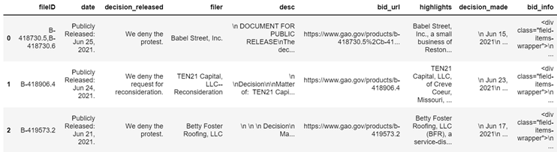
RAW OUTPUT
Raw output from scraping gao.gov

Slide 13
DATA CLEANING

Slide 14
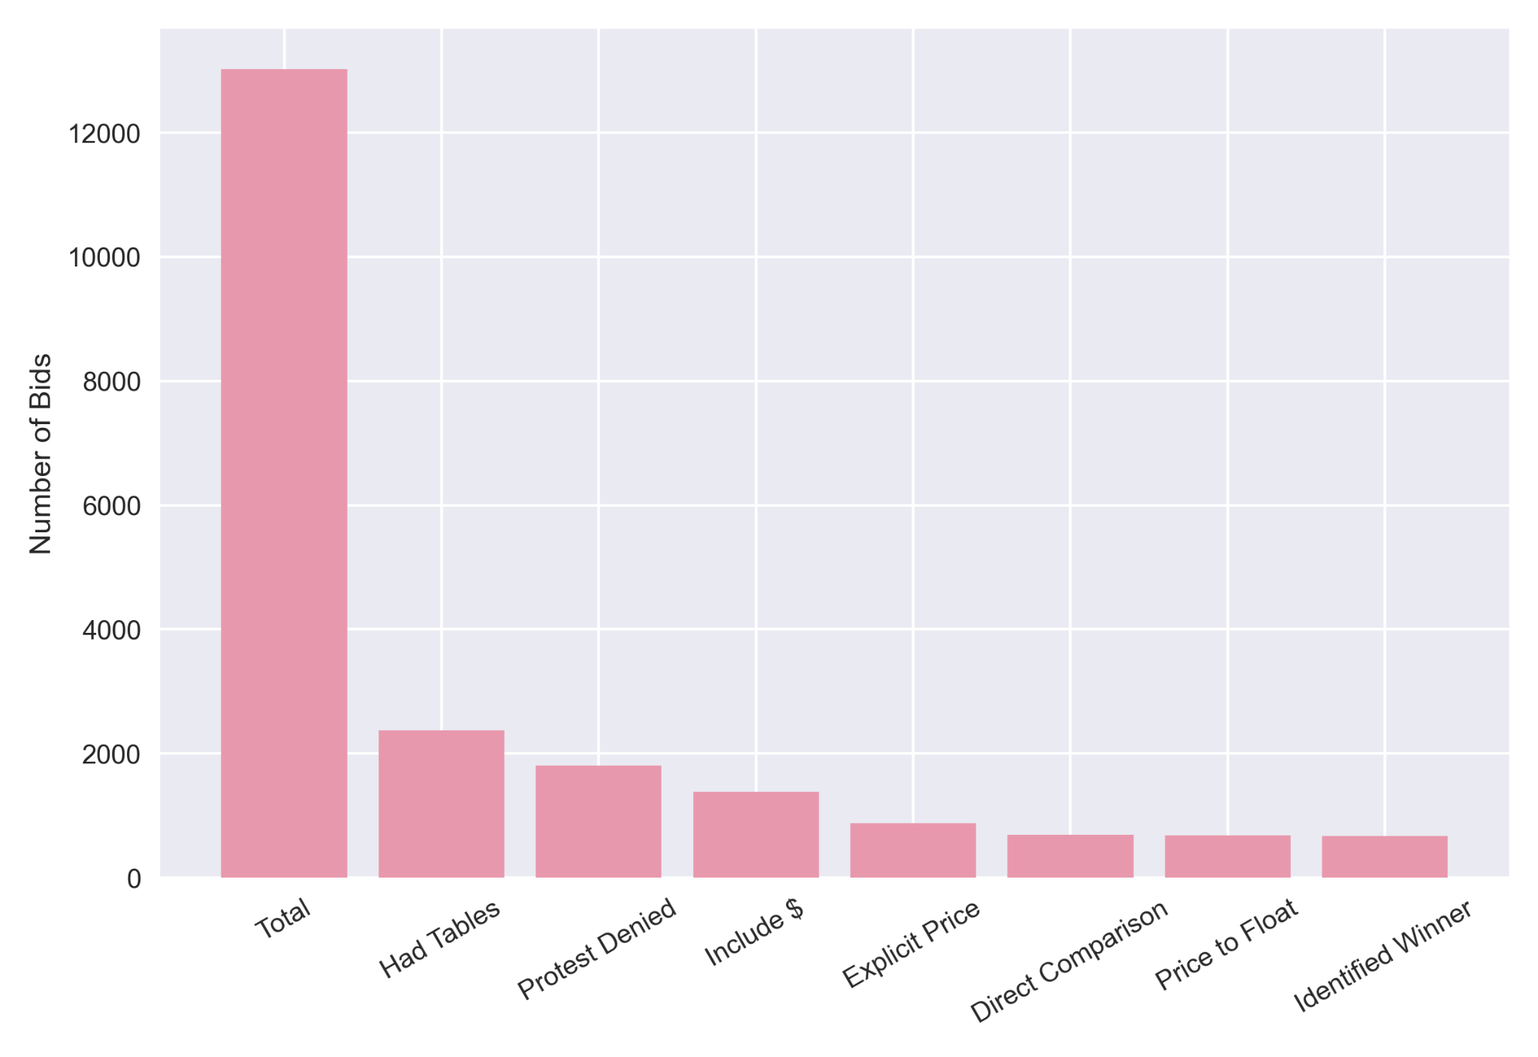
DATA CLEANING FUNNEL
Data loss at each step in the data cleaning process

Slide 15
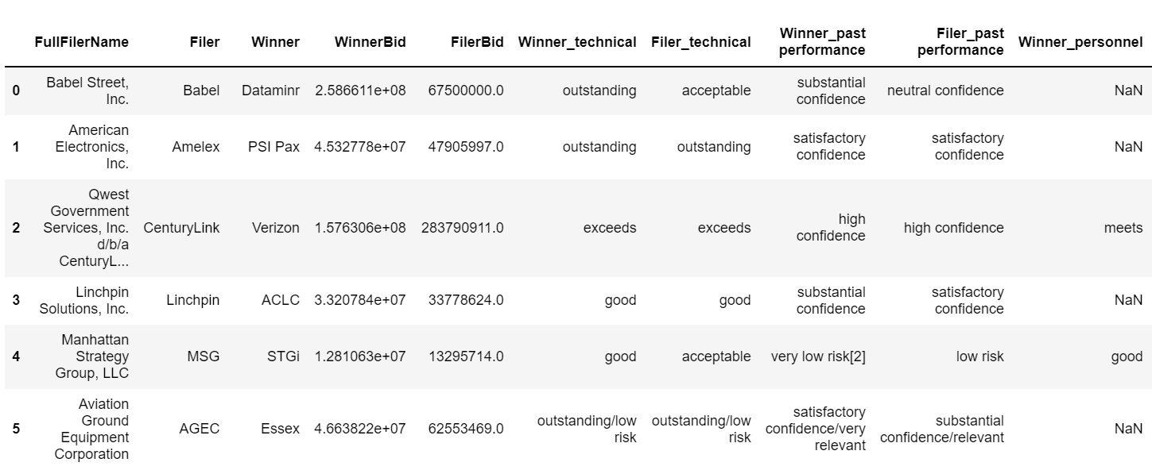
ALMOST THERE!
Cleaned outputs including factor descriptions

Slide 16
FACTOR MAPPING
NEGATIVE
POSITIVE
-1
1
0
Unacceptable, fail, high risk, did not meet requirements, limited confidence, red, F
Outstanding, pass, low risk, exceeds requirements, high level of confidence, blue, A

Slide 17
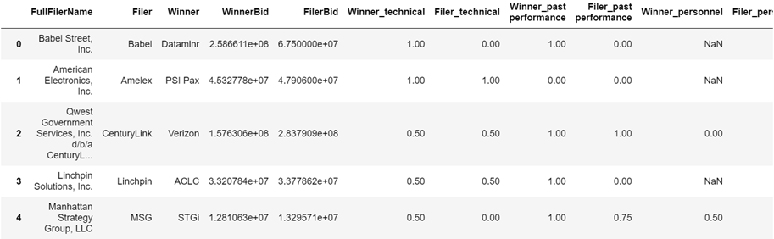
CLEANED DATA
Cleaned output from unholy hours of data cleaning

Slide 18
DATA ANALYSIS

Slide 19
$128,954,104,688
Money won by contracts in this tiny subsample

Slide 20
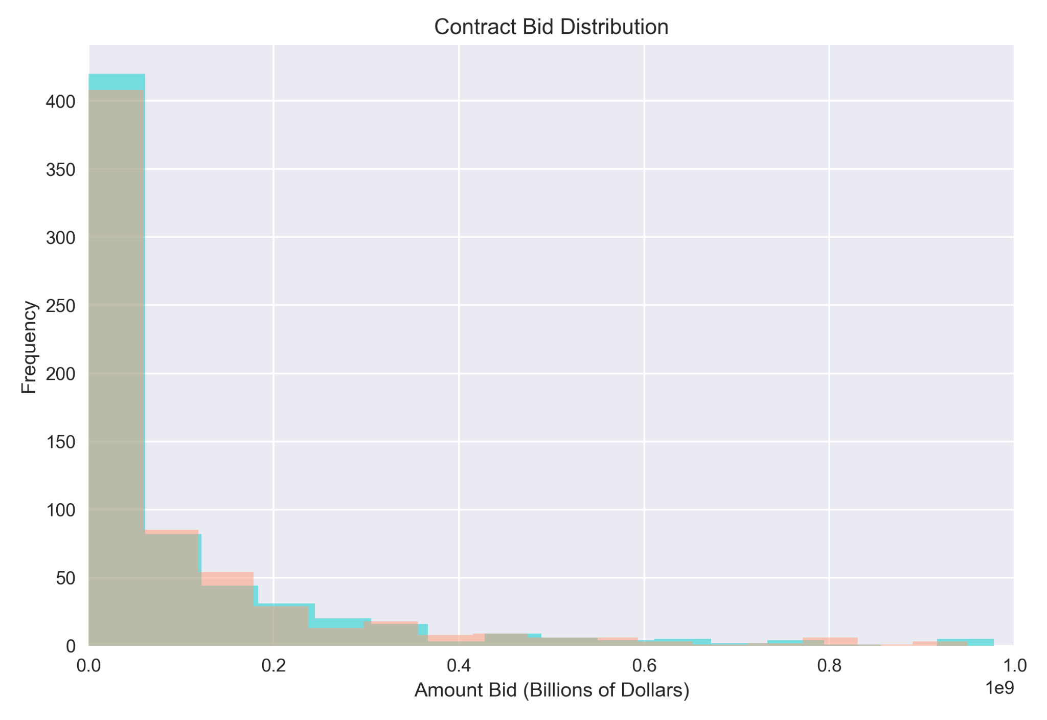
TWO-TAILED NHST
NULL
RESULT
ALTERNATIVE
There is no statistically significant difference between the average price bid by winners and losers of a contract.
P-Value: ____
There is a statistically significant difference between the average price bid by winners and losers of a contract.

Slide 21
TWO-TAILED NHST
NULL
RESULT
ALTERNATIVE
There is no statistically significant difference between the average price bid by winners and losers of a contract.
P-Value: 0.97
There is a statistically significant difference between the average price bid by winners and losers of a contract.

Slide 22
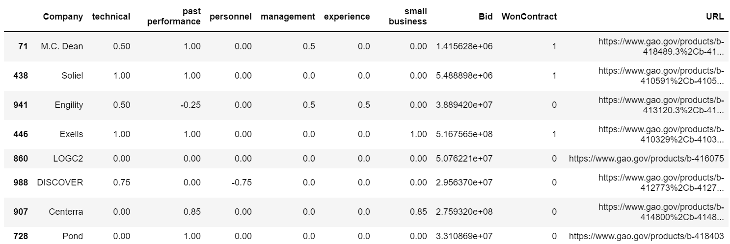
PREDICT WHETHER BID WINS CONTRACT
Cleaned data refitted for model building

Slide 23
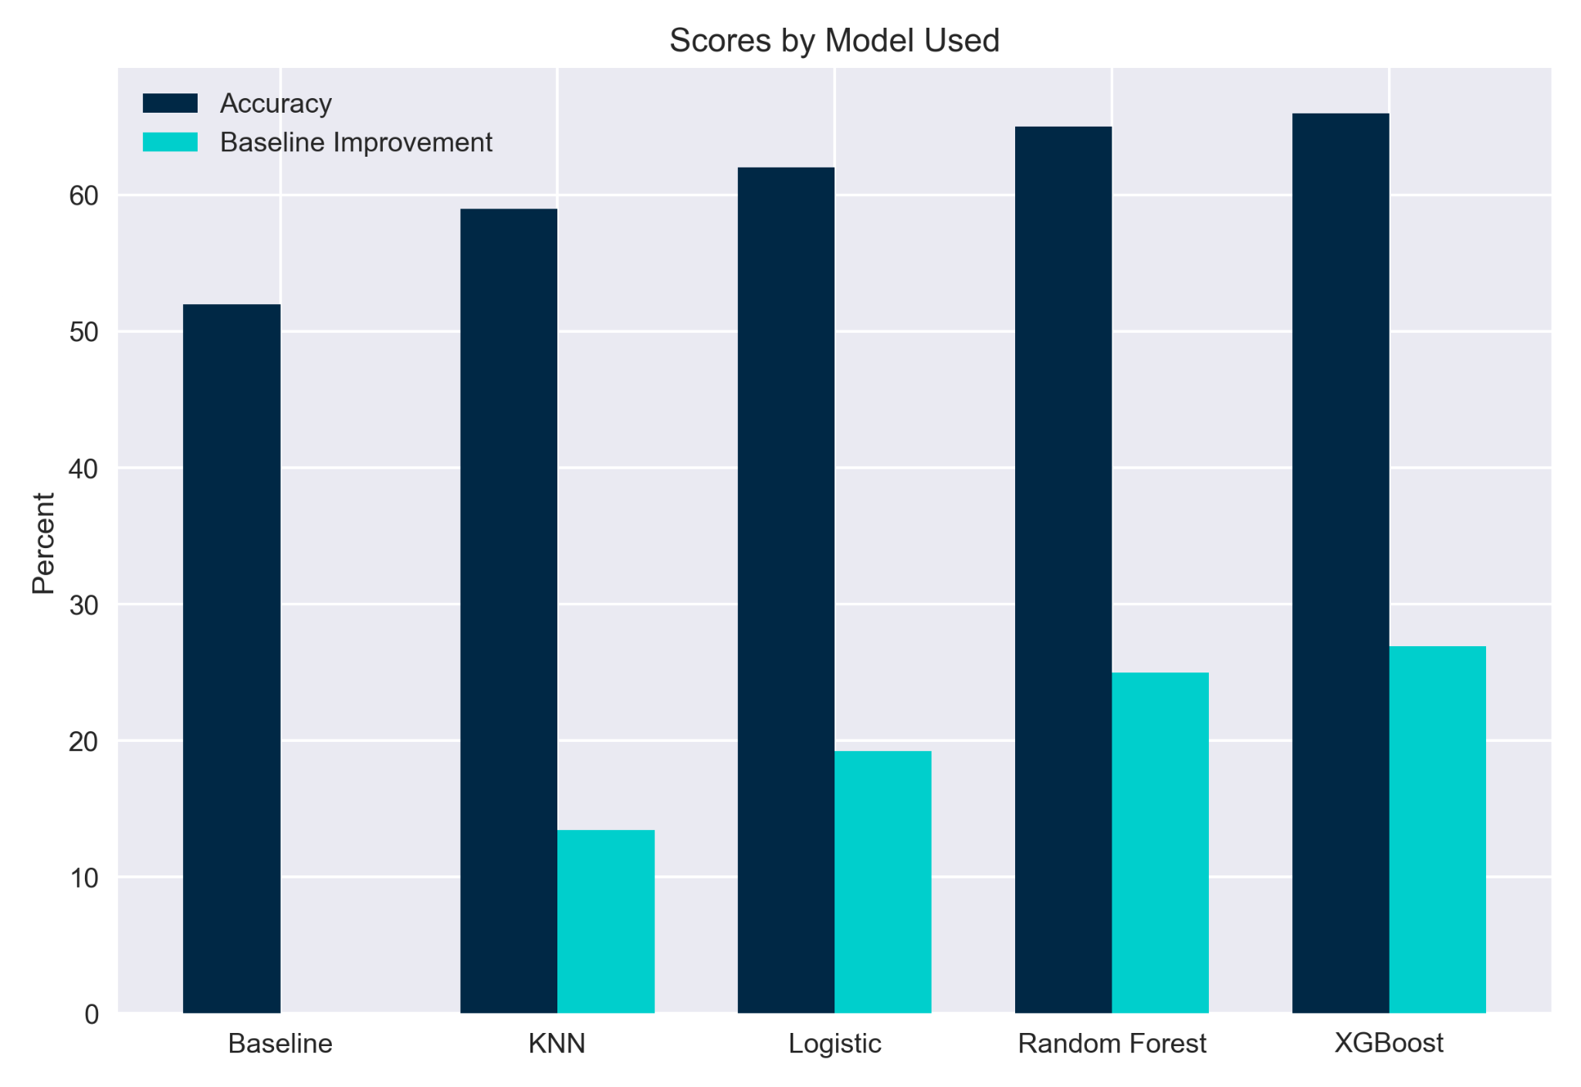
MODEL PERFORMANCE

Slide 24
RESULTS
03
Primary takeaways and potential next steps

Slide 25
MINOR AVERAGE DIFFERENCES
EXPERIENCE
PAST PERFORMANCE
SMALL BUSINESS
You have accomplished a task in this area of expertise
You have provided strong results before
Your approach incorporates and enriches small businesses

Slide 26
MAJOR AVERAGE DIFFERENCES
TECHNICAL
MANAGEMENT
PERSONNEL
You demonstrate the skills to complete the task
Your proposal has strong leadership
The people used in this proposal are well-qualified

Slide 27
PROJECT TAKEAWAYS
—WINNING TIP—
—FOCAL POINT—
—MARKET INSIGHT—
—WINNING TIP—
—MARKET INSIGHT—
—FOCAL POINT—
We failed to reject the null hypothesis, bid price isn’t the main factor that determines contract proposal success
Winning contracts bid an average of ~1.8% higher than their competitors
$130 billion was accounted for in this tiny subset of GAO data, but there is a lot more research to be done
Winning contracts never received an unacceptable (-1) rating in any field
76% of GAO protests are (at least partly) denied, bid proposal decisions are often final
The biggest differences between winners and losers was in their technical rating

Slide 28
FUTURE WORK
REGRESSORS
SENTIMENT ANALYSIS
04 WEEKS
36 WEEKS
01 WEEK
12 WEEKS
DATA CLEANING
PREDICT DECISION
Formalize the scoring system for changing factors into numbers
Use regressors to determine the premium you can charge per bid
Use the factors returned from the contract results to decide whether to submit a bid protest
Improve data filtering process to reduce wasted data

Slide 29
QUESTIONS
Contact
Billy Hayes
hayes_william@bah.com
Please keep this slide for attribution

